Slide 1
Autolayout for everyone
My (one way) journey into land of autolayout
Krzysztof Kucharewicz
krix@mobilejazz.cat
@mobiosis
Logroño, 18/09/2014
Notes:
Welcome everyone.
My name is Krzysztof, I’m a mobile software developer at MobileJazz. I’m happy to be with you today and I will speak about auto layout in practice.

Slide 2
What I will talk about
A short history of Autolayouts
How to stop using Frames
How to adapt to screen orientation and size
Autolayout by code and in IB
Useful libraries (Lyt, NibWrapper)
Animating with constraints
Debugging autolayout
Notes:
Let me give you a short introduction first
I will tell you where auto layouts come from and how they evolved.
I will show you how to transform a Frame-based layout into a fully-automatic AutoLayout.
I will also give you an idea how you can create common rules for layouts that will work equally well in different screen sizes, specifically when rotating screen.
We will see some layouts created by code, others in Interface Builder.
I will introduce two very helpful (almost required) libraries for day-to-day work with AutoLayouts
We will do some animations
And we will debug broken layouts

Slide 3
What I will not talk about
How to separate your designs between the different device types with size qualifiers (w:… h:…)
How to make your animations smooth with Spring animations
How to prepare your assets for the new form factors and resolutions
Check WWDC 2014 videos to learn about that https://developer.apple.com/wwdc/videos/
Notes:
What I will not be talking about is:
Size Classes introduced in Xcode 6
Animations with Springs (which are virtually the same in terms of API as normal view animations)
Requirements for assets in new devices
You can learn about it from the WWDC 2014 videos though

Slide 4
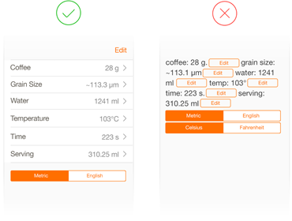
What I will not talk about
How to create a great UX
https://developer.apple.com/app-store/review/rejections/
Notes:
I also wont talk about how to create a great User Experience in your app, because you should have learned it by now

Slide 5

What I will not talk about
How to make yourselves rich
http://www.bet.com/news/national/2013/01/08/american-money-250k-a-year-rich-or-not-rich.html
Notes:
I won’t tell you how to get rich on the App Store either

Slide 6
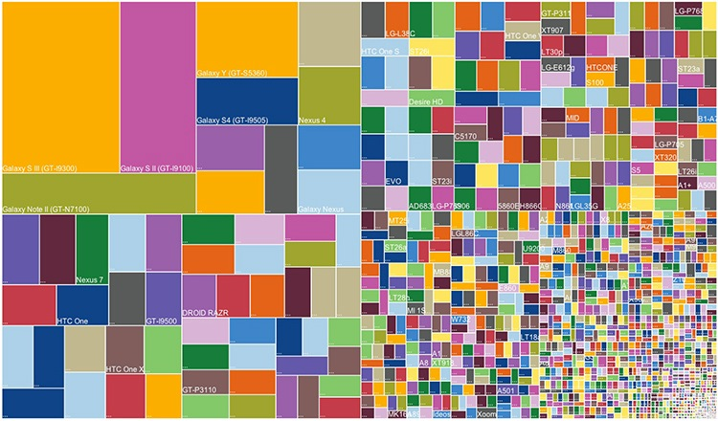
What I will not talk about
Other ecosystems’ fragmentation
http://www.fastcodesign.com/1673162/the-disintegration-of-android-visualized
Notes:
And I won’t even mention how fragmented in terms of device sizes and variants other ecosystems are…
(pause 5s)

Slide 7
History of Autolayouts
Autolayouts were introduced in iOS 6 (OS X 10.7)
They are a way to move from Imperative to Declarative interfaces
Support for Autolayouts in Xcode has gone through various iterations, where Xcode 4.6 was not the best one to start with
They are still a taboo for many programmers
Notes:
Autolaouts were only introduced only 3 years ago on Mac OS X
and even 1 year later on iOS
They fulfil the need to create Declarative interfaces where we say what relations UI elements have, instead of saying exactly where they are.
If you heard bad opinions of Autolayouts from someone using Xcode 4.6, you should give it a try again. It changed a whole lot since then.
If you are afraid to talk about it, you’re in the right room right now.

Slide 8
Why autolayouts?
1. No more setFrame
autolayout uses declarative interfaces
frame is calculated each time based on constraints
invoke the layout by calling [view layoutIfNeeded] [view setNeedsLayout]
you can combine the frame-based layout with autolayout (no need to switch to autolayout right away)
Notes:
There are some great reasons why you should use Auto Layouts
Frames are in the past since we have multiple resolutions right now.
Of course Apple did their best to make “fixed” interfaces work, but for the moment their logic behind it creates only confusion http://stackoverflow.com/questions/25755443/iphone-6-plus-resolution-confusion-xcode-or-apples-website
Thus it’s better to use AutoLayout and Constraints
Once you create all the constraints, you need to remember to let the system know it has to recalculate all the views
You don’t need to switch to AutoLayout right away though. Even if your Xib file doesn’t have the “Use Auto Layout” ticked, you can add sub-views using AutoLayout internally

Slide 9

Why autolayouts?
2. One layout fits all
3. Translations
4. New form factors
5. Because challenges are fun...
Notes:
If your design is not very different between iPhone and iPad, you can have it all in one scalable layout file
AutoLayout adapts very well to different text lengths so you’re less likely to break it with too long strings.
Obviously it all comes down to the fact that there is not only one iPhone, so the logic behind the view positioning would get too complex if done manually.
And of course if you have a R&D spirit, you might like it for the sole fact of having to learn something new.

Slide 10
Creating autolayouts
Interface builder
helps creating all the constraints for you
will show error on insufficient layouts
will show warning in case of ambiguity
layouts created automatically can be pretty useless when not attended in detail
Notes:
Interface builder become a very powerful layout modelling tool by now so it might likely be first thing you do when you jump into AutoLayout land.
It will help you debug basic relations and show ERRORS
Or WARNINGS when your layouts stop being consistent
But don’t use “Add missing constraints” to make your life easier, as it probably won’t do much better than setting the fixed rectangle for each view

Slide 11
Creating autolayouts
By code
ASCII art V: is an axis, (together with H:)
| is a bound
[item] is a view
(==100) is a fixed size constraint,
might also be >= or <=
@123 is a priority
- is a spacer (recommended size by default)
Notes:
We can also do it all by code, and even though it loses all transparency of view relations and positioning, it might be sometimes required for things that you cannot easily do in IB or when you’re animating views.
[START]
So creating auto-layouts can be done semi-visually with the “ascii art”

Slide 12
Creating autolayouts
i.e. "V:|[viewA]-[viewB(==100)]-(==10)-[viewC(>=50@900)]-|"
viewA
viewB
100
10
viewC
50+
Notes:
This relations means we want to order views vertically, starting from the edge, viewA without a size specifier, default spacer, viewB with height of 100, spacer of size 10, and viewC with height of 50 or more but can be shrunk if other views don’t have enough space (priority 900)

Slide 13
Creating autolayouts
By code
With a long method
NSLayoutConstraint *con1 = [NSLayoutConstraint
constraintWithItem:self.imageLock
attribute:NSLayoutAttributeBottom
relatedBy:NSLayoutRelationGreaterThanOrEqual
toItem:self.labelStatus
attribute:NSLayoutAttributeBaseline
multiplier:1
constant:3];
con1.priority = 100
Which represents the equation "view1.attr1 <relation> view2.attr2 * multiplier + constant"
Notes:
We can also use this long method which seems pretty cumbersome, but is much more powerful when it comes to specifying complex relations.

Slide 14
Priorities
Range from 0 (ignored?) to 1000 (required)
Have some special meanings (see in IB)
Content Hugging Priority (wraps around the content tightly when high)
Compression Resistance (avoids shrinking/shortening when high)
Notes:
Priorities have values of 0 to 1000
They can have some intermediate values which are set by default for some parameters
We have a Hugging Priority which is making views compact
We have Compression Resistance which avoids shrinking views too early

Slide 15
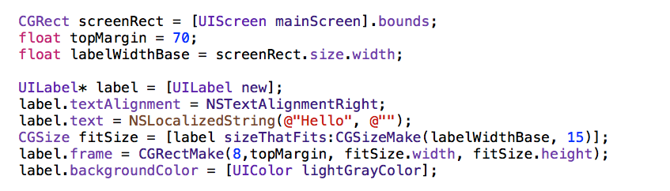
Example
Calculating layout with frames is cumbersome
Notes:
Manual layouts require quite a lot of logic
We need to take the device width, calculate how much would the label occupy to align it with other items.

Slide 16
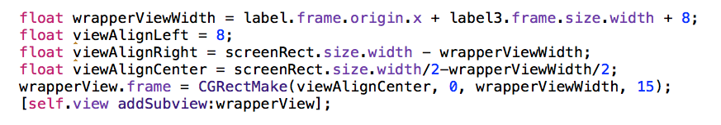
Example
Calculating layout with frames is cumbersome
Notes:
It’s much less transparent.
And it’s easy to make a mistake.

Slide 17
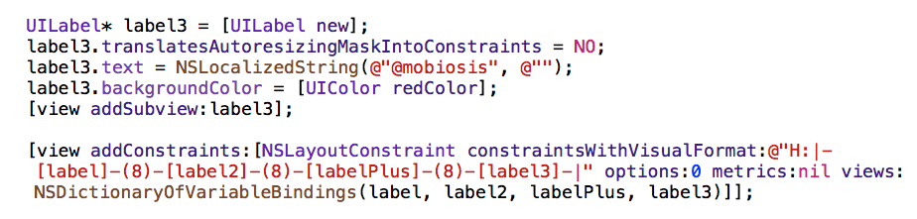
Example
Using Auto Layouts give much more transparency
Notes:
When using auto layouts, we only care about content, and the relations with parent and sibilings

Slide 18
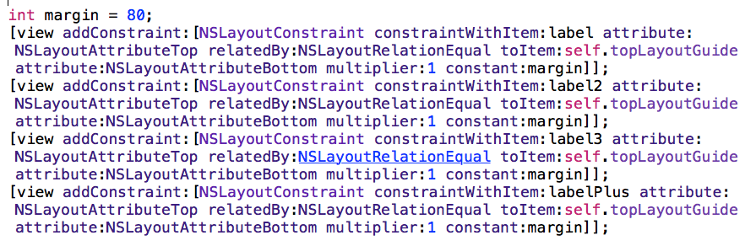
Example
Even though it might require more lines of code
Notes:
At times it might require a few extra lines of code though
We need to add these constraints separately to align each item vertically.

Slide 19
Demo
Notes:
(3min)
Code example
show multiple objects aligned in line
rotate the screen
mention the lack of alignment
vertical displacement is broken
autolayout recalculates the constraints when needed

Slide 20
New in iOS8 and Xcode 6
View margins independent of the layout constraints UIView.layoutMargins UIView.preservesSuperviewLayoutMargins
Activating constraints on-demand NSLayoutConstraint.active
Notes:
We are able to set the view margins independently of the constraints of the items assigned to subviews
That works pretty much like in CSS or XML declarative interfaces We also don’t need to remove constraints when not needed, but de-activate them that effectively is omitted when calculating layout.

Slide 21
Animations
Animations are easy to achieve with constraints UIView animateWithDuration:1.5 animations:^{
//remove all, add new constraints here
[view removeConstraint:self.topConstraint];
[view addConstraint: [NSLayoutConstrait … ]];
//when finished, request UI to lay it out
[view layoutIfNeeded];
}
You have to remember to call layoutIfNeeded after adding all constraints in the animation block
Notes:
Animations are pretty straightforward
You only need to remove old layout and add a new layout in the animation block
Don’t forget to call “layoutIfNeeded” after adding all constraints in the animation block

Slide 22

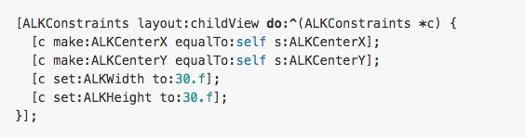
Popular Auto Layout libraries
AutoLayoutKit
Notes:
I’ve chosen the most popular Auto Layout libraries from CocoaPods and here are the examples
This one decided to create it’s own Enums which surely complicate the casual usage

Slide 23

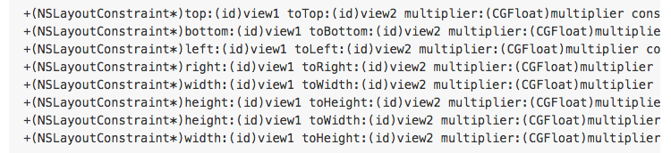
Popular Auto Layout libraries
DRAutolayout
Notes:
This one decided to replace very long methods with just long methods. Not too much improvement, huh?

Slide 24

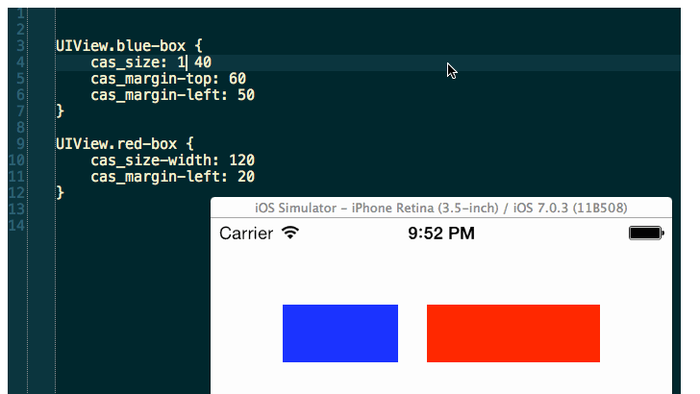
Popular Auto Layout libraries
ClassyLiveLayout
Notes:
This is an interesting concept, especially for prototyping, but not sure if the right choice for production apps.

Slide 25

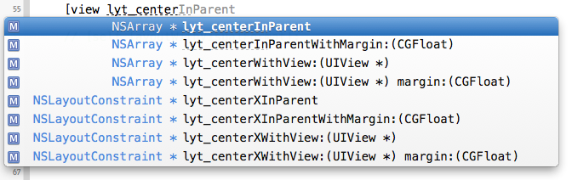
Popular Auto Layout libraries
Lyt
Notes:
Lyt uses concise and compact method names for various configurations of constraints

Slide 26

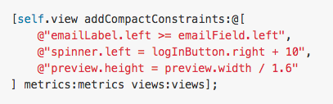
Popular Auto Layout libraries
CompactConstraint
Notes:
This one is very popular, but I don’t see much point in replacing rather controversial one visual language with the other

Slide 27
Useful libraries
Lyt https://github.com/robotmedia/Lyt
Shortens NSLayoutConstraint call to a concise and self-explanatory method
Always finds a common parent for correct constraint placement
Good for frequent use with simple relations
Not so good for chaining multiple views
Does not allow setting priorities
You should avoid using it to just convert frames to constraints with lyt_setFrame:(CGRect)frame;
Notes:
So my choice goes to Lyt It can be very useful
…
but it also has it’s weak points

Slide 28
Useful libraries
NibWrapper https://github.com/mobilejazz/NibWrapper
For easier reusing of the UI elements
Design a view layout in the IB (xib file)
Create a custom controller class
Encapsulate it with NibWrapper
Add to your layout like if it was another UI control provided with the SDK
Notes:
NibWrapper helps you reuse your custom views almost like if it was part of the Interface Builder

Slide 29
Demo
Notes:
(3min)
We have used the Lyt library to help us create constraints quicker.
added view
added constraints
animating to another position
NibWrapper
Show ATUserProfile.xib
Show how it is used in the Storyboard
Rotate and explain how the image gets resized to 1/3 in ATUserProfile.m

Slide 30
Debugging the layouts
Execute in the console [view hasAmbiguousLayout]; [view exerciseAmbiguityInLayout]; [view constraintsAffectingLayoutForAxis:0]; //1
Not available yet in iOS (only Mac OS) [[UIWindow keyWindow] autoLayoutTrace]; [window visualizeConstraints];
Notes:
We have a bunch of tools we can use when things go wrong in the layout system
Following methods are very useful

Slide 31
Debug the layouts
break on objc_exception_throw
in Scheme > Settings add to see long strings NSDoubleLocalizedStrings = YES;
and other less useful variables AppleTextDirection = YES; NSForceRightToLeftWritingDirection = YES; NSShowViewAlignments = YES; UIShowViewAlignments = YES;
Notes:
Additionally we can help us prevent issues by
watching for exceptions
setting strings to long

Slide 32
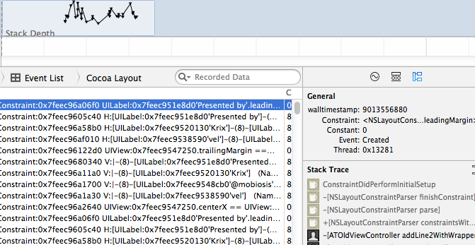
Debug the layouts
Xcode Instruments has a useful tool Cocoa Layout for recording layout changes
Notes:
Cocoa Layout allows us to record all layout changes (adding/removing constraints) and we can track each of them to the code that called it

Slide 33
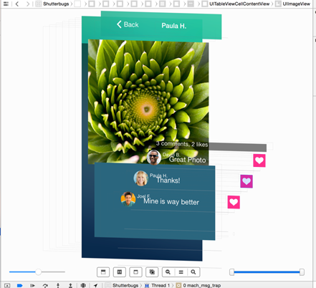
Debug the layouts
There’s also new layout inspector tool in Xcode 6
3rd party apps RevealApp or SparkInspector provide useful insight into view during runtime

Slide 34
Demo
Notes:
(3min)
- change the language
[START]
break on “view did layout subviews”
[self.line2 hasAmbiguousLayout]
remove the “wrapper view”
[START]
- rotate and show that there is still some ambiguity
add a “exercise the layout” button
[START]
- exercise the layout to show different behaviour on each recalculation
Run INSTRUMENTS > Cocoa Layout
- show how to record and track button added

Slide 35
Pro tips
When creating UIView by code, always set [view setTranslatesAutoResizingMaskIntoConstraints:NO];
Remove duplicate constraints before adding new [view removeConstraint:self.someConstraint]; self.someConstraint = [NSLayoutConstraint ... [view addConstraint:self.someConstraint];
Compression Resistance and Hugging Priority are keys to handling complex layouts

Slide 36
Where to find more
Coding Together
Lecture 8 - https://itunes.apple.com/us/course/coding-together-developing/id593208016
WWDC 2012
202 - Introduction to Auto Layout
228 - Best practices for mastering Auto Layout
232 - Auto Layout by example
WWDC 2013
406 - Taking control of Autolayout in XCode 5 (...instead Autolayout taking control of XCode 4.6)
WWDC 2014
411 - What’s new in Interface Builder

Slide 37

Questions?
Don’t be shy
http://www.manchester-cattery.co.uk/

Slide 38
Follow me
http://github.com/mobiosis
@mobiosis

